Slide 1
ARDUNIO
Object Detection Using Sensor

Slide 2
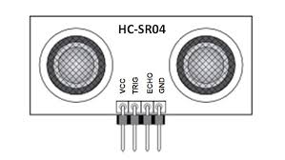
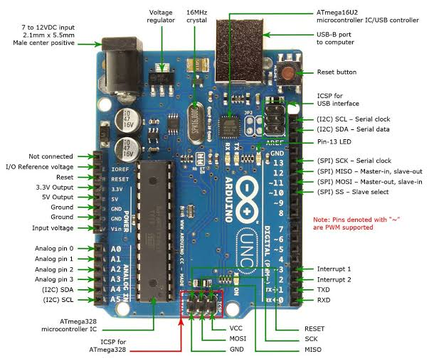
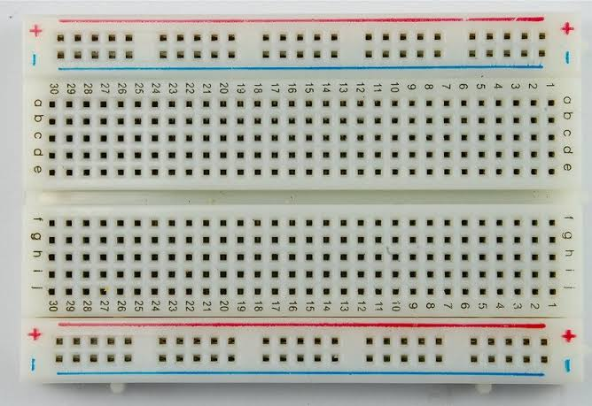
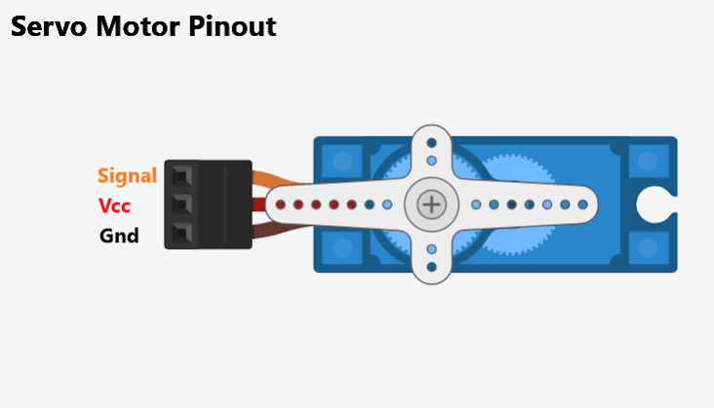

Slide 3

ARDUNIO :
RED – 5V
BLACK - GROUND
SERVO :
RED – 5V
BLACK – GROUND
YELLOW – PIN 12
SONAR :
VCC – 5V
GND – GROUND
TRIG – PIN 10
ECHO – PIN 11

